Slide 1
Becoming a Digital Teacher: new competences, new knowledge, new activities
Michael Carrier
Highdale Learning
CA Symposium 2017, Brno

Slide 2
What does the Digital Teacher
need to know?
Overview
Digital learning is here to stay
Digital skills
Digital teaching competences
Digital Teacher Framework
Digital training
Future directions

Slide 3
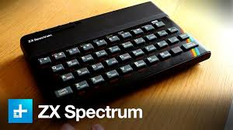
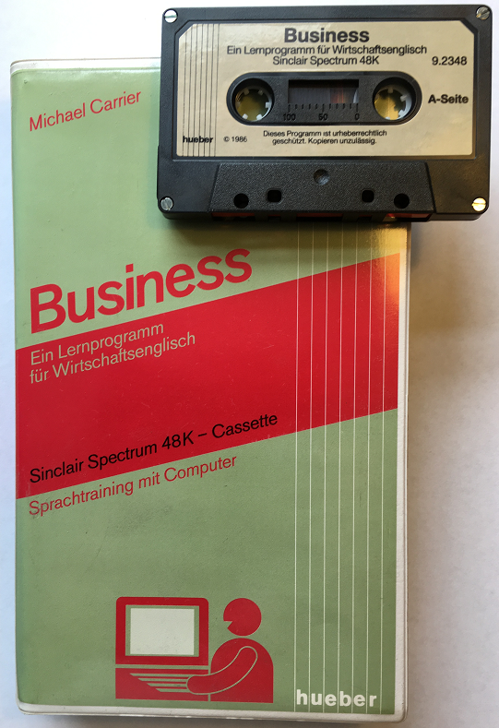
From the Spectrum... to MOOCS: Digital learning is here to stay

Slide 4
It’s not Technology..… but Pedagogy
“Digital Learning is learning facilitated by technology that gives students some element of control over time, place, pathway and pace”
(Digital Now Foundation, 2014)

Slide 5
ELT Trends
Digital disruption
Ubiquity
Personalisation
Individualisation
Adaptive learning & testing
Speech-enabled tech
Auto-grading research
Rise of instrumental English
Decline of general English: ENPP
Rise of EMI & other ESPs
English opens doors to:
Education
Employment
Mobility
A clear driving force has been the push towards language for career development… students want to put the language into ‘action’
Study Travel magazine

Slide 6
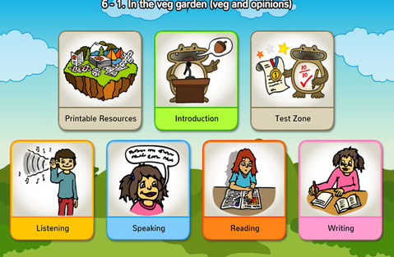
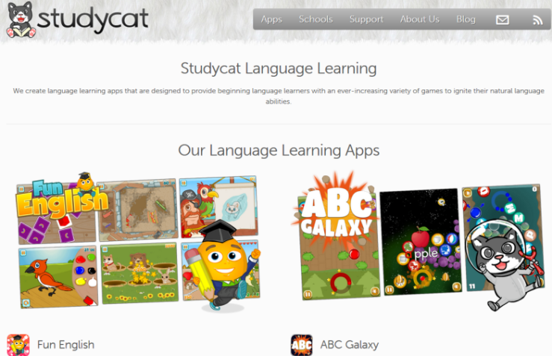
Digital
Learning
Tools, resources, apps, sites, gizmos……

Slide 7
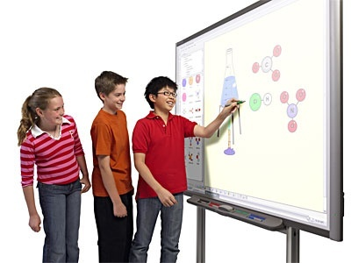
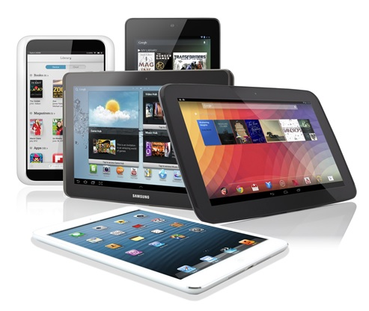
Digital learning channels
In-class channels:
IWB
Digital textbooks
1:1 & BYOD
PRS systems
Out of class channels:
Handheld
LMS
Apps
Web
Individualisation

Slide 8
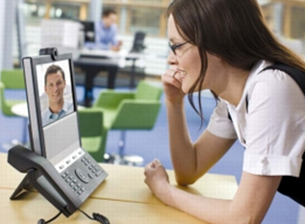
Remote teaching
Virtual Classroom
MOOCs
Virtual Community

Slide 9
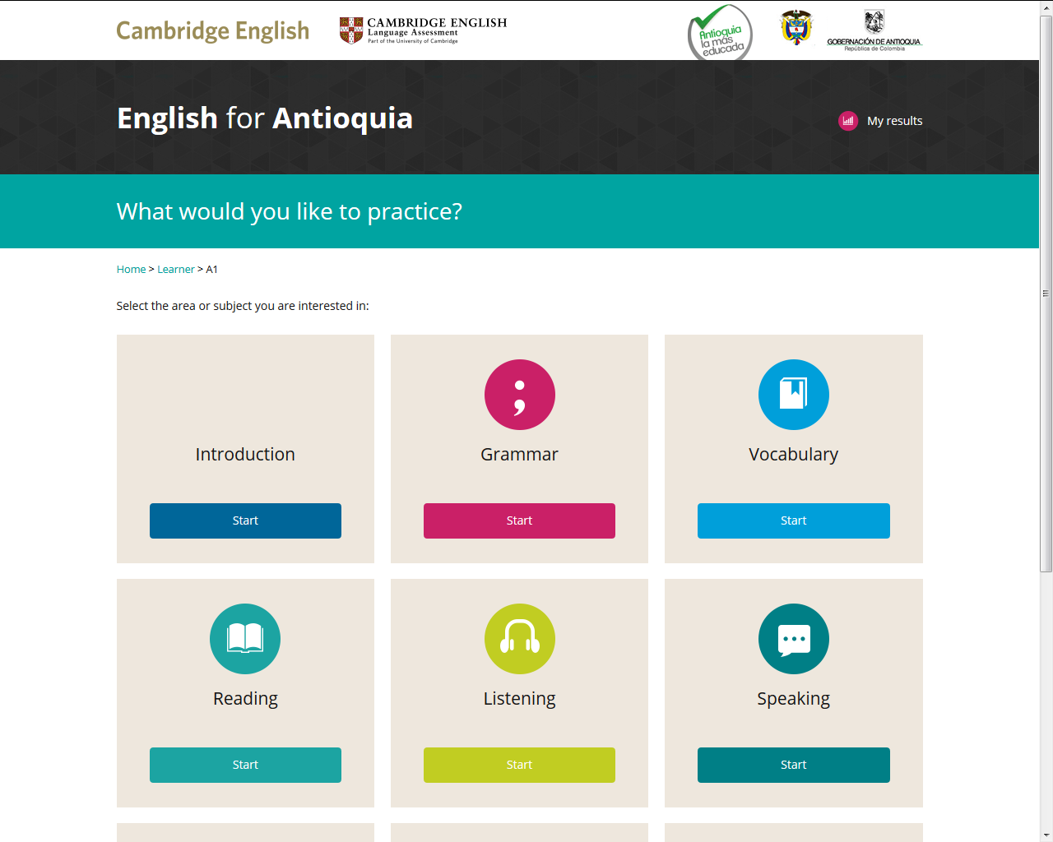
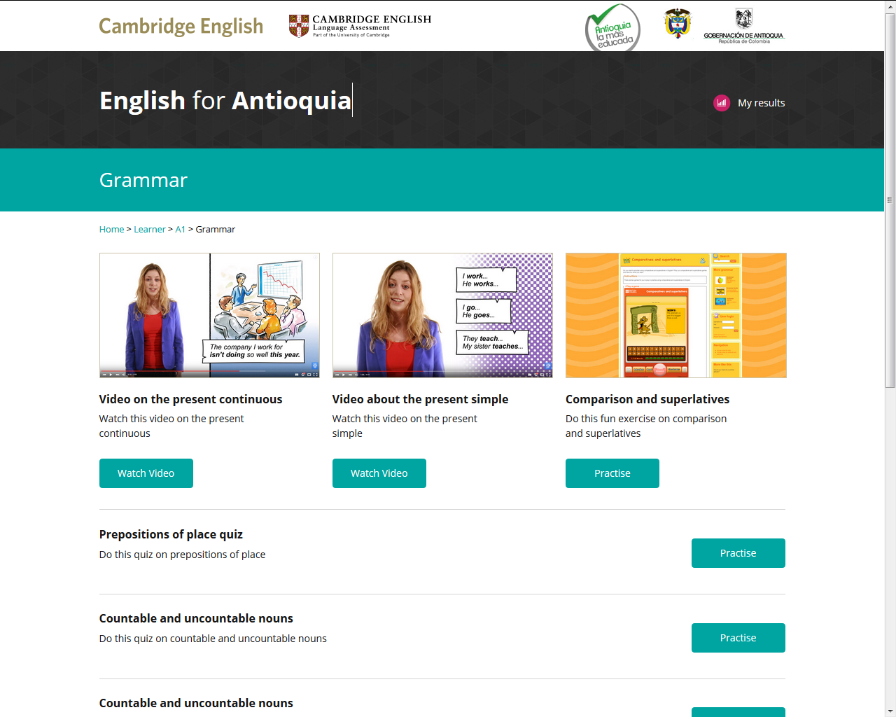
Open Educational Resource (OER) portals

Slide 10
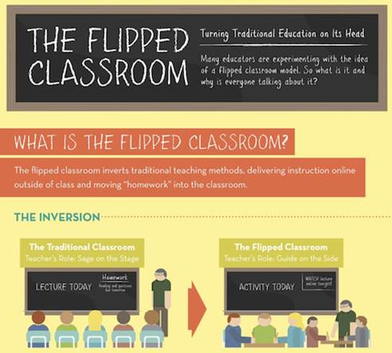
What does the Digital Teacher
need to know?
Digital pedagogical models
Blended learning
Mobile learning
1:1 classrooms
Flipped classroom
Adaptive learning
Personalisation
CB assessment

Slide 11
In-class vs Out-of-class models
In Class
Activities:
Speaking activities
Pairwork
Concept questions
Communication activities, games storytelling
Mentoring
Before Class
After Class
Activities:
Reading & Listening activities
Study text
Learn vocab online
Grammar in Use activity with Apps
Activities:
Writing
Comprehension Qs
Online workbook
Vocab practice apps
Formative assessment

Slide 12
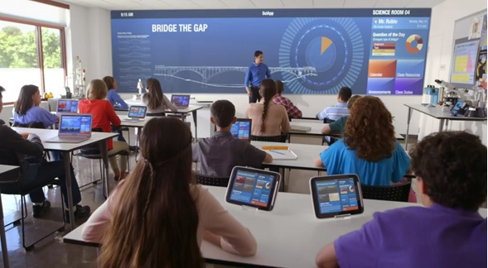
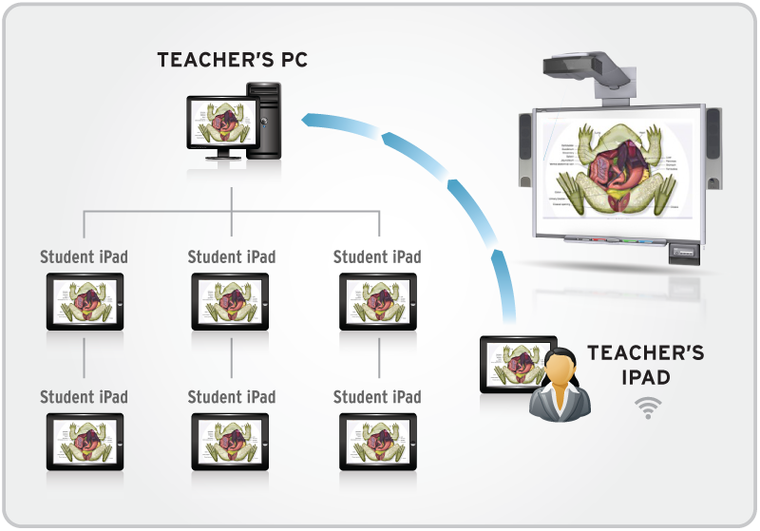
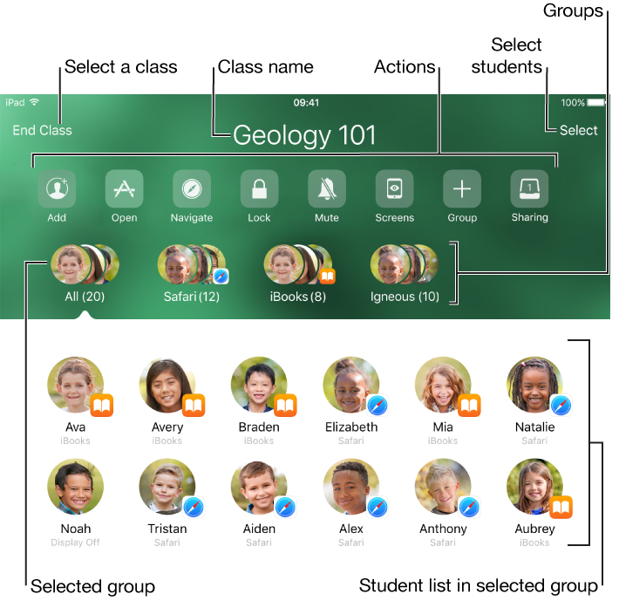
1:1 learning & classroom management
www.menti.com

Slide 13
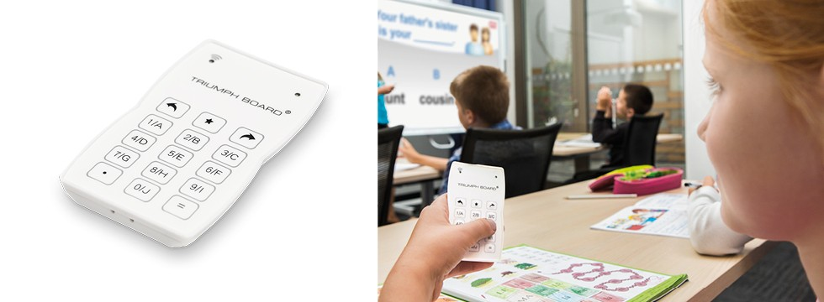
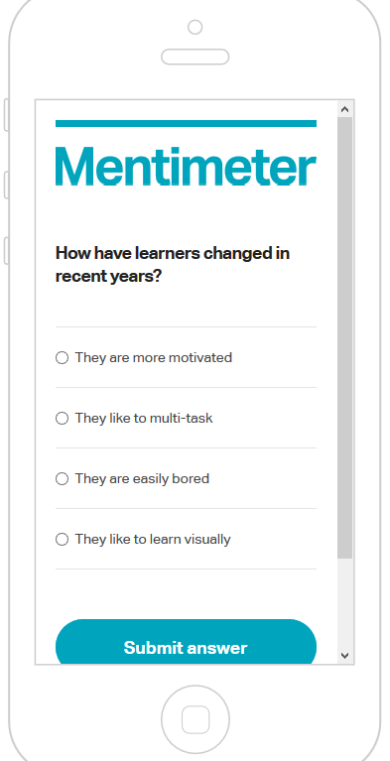
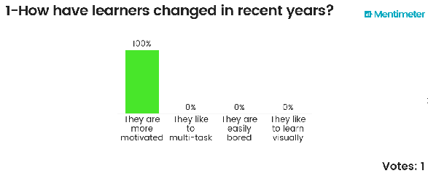
Voting/Personal Response Apps
Go to: www.menti.com & Enter code: 327786
https://www.mentimeter.com/s/0a86dc05b62bd39acc2b0528dac328e4/27f0f3bdabe7

Slide 14
Do you speak digital?
I speak Geek
BYOD
VLE
Flipped
Blended
IWB
VR
AR
SMS
Airplay
Bluetooth
Reflection
Score yourself out of 10 for concept recognition

Slide 15
Some new ‘Digital Teaching’ skills:
Which new pedagogical models to use
Which new technology tools to use
Which new materials and resources to use
How to guide the students’ digital interactions
How to get support in curriculum & course development
How to get investment in training & development
How to manage a virtual classroom
How to create new content with students
The Digital
Teacher needs to know…..

Slide 16
Aligning tools with course design
Input Technology | Classroom Management | Content delivery | Interaction | Assessment | Teacher training
Screens | Netop | Apps | Differentiated groups | Quizzes | Usage
IWB | Smartclass | Sites | PRS voting | LOA | Selection
Touch | Chimpa | Portals | ASR | Adaptive | Evaluation
Reflector | Apple Classroom | AR/VR | Write & Improve | Creation | Creation

Slide 17
Developing an Activity taxonomy
task | individual | group
Consuming content: Grammar study | √
Self-access quiz | √
Reading | √
Listening | √
Vocabulary | √ | √
Producing content: recording/interviewing |  | √
storytelling/writing | √ | √
phonecasting |  | √
phoneblogging | √
upload & share projects |  | √

Slide 18
Developing a personal tech toolkit
Devices toolkit:
Audio/video equipment
IWB
Laptop + projector
Tablet + projector
OTPS – Tablet class set
Systems toolkit:
Class management software & Airplay
Assessment
VOIP – Skype
VLEs – Moodle, Blackboard
Resources toolkit:
Wikis
Blogs
Facebook
Twitter
Slideshare
Dropbox
Prezi
Apps
App stores
iTunesU
MOOCs

Slide 19
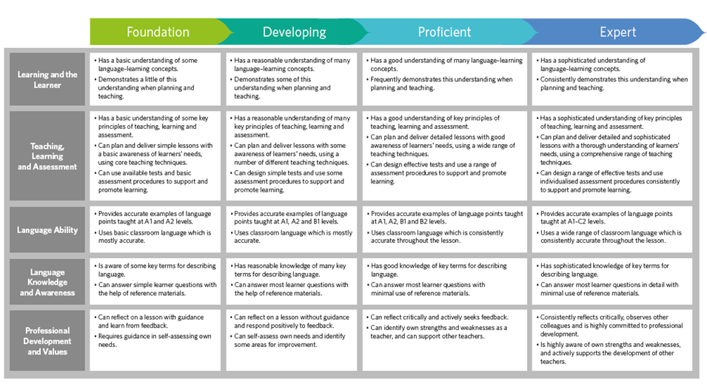
Cambridge CPD Framework
The Digital
Teacher: competence
frameworks

Slide 20
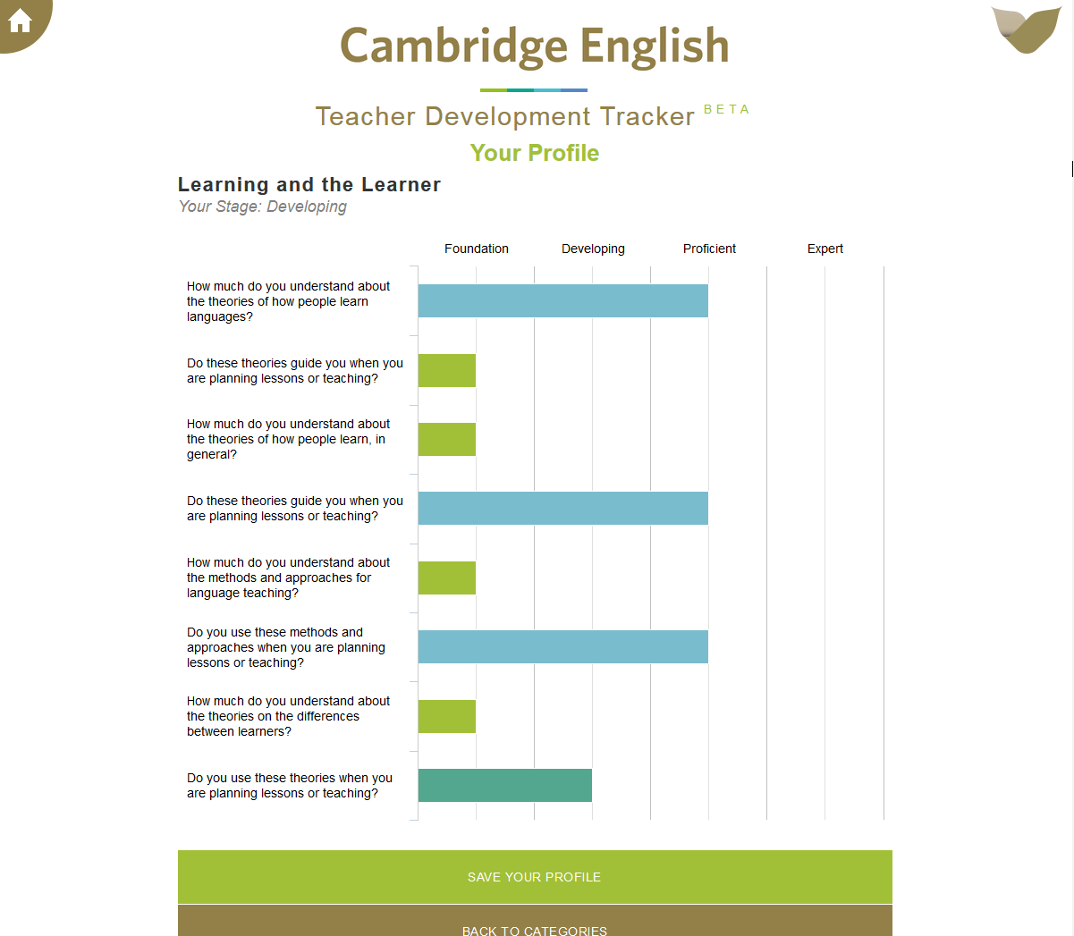
http://Tracker.cambridgeenglish.org

Slide 21
EAQUALS TD framework

Slide 22
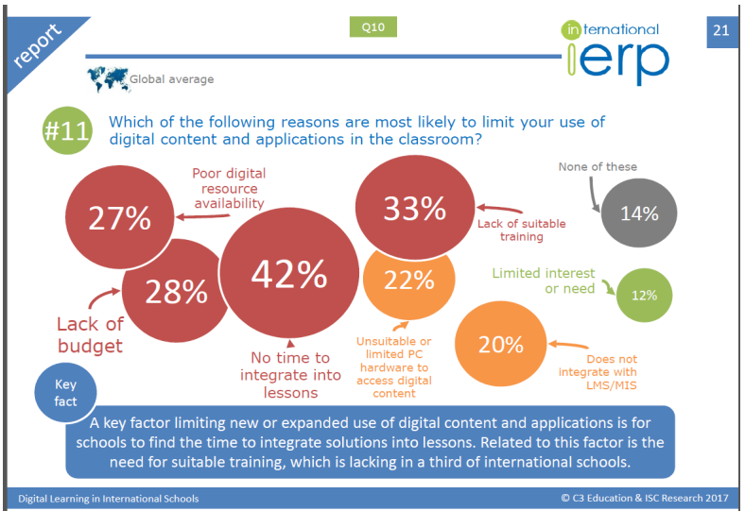
The Digital
Teacher:
A Digital Competence
Framework

Slide 23
UNESCO ICT framework

Slide 24
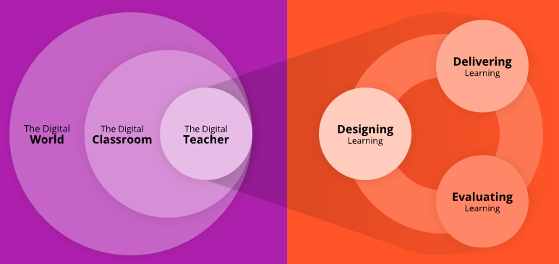
Cambridge Digital Framework

Slide 26
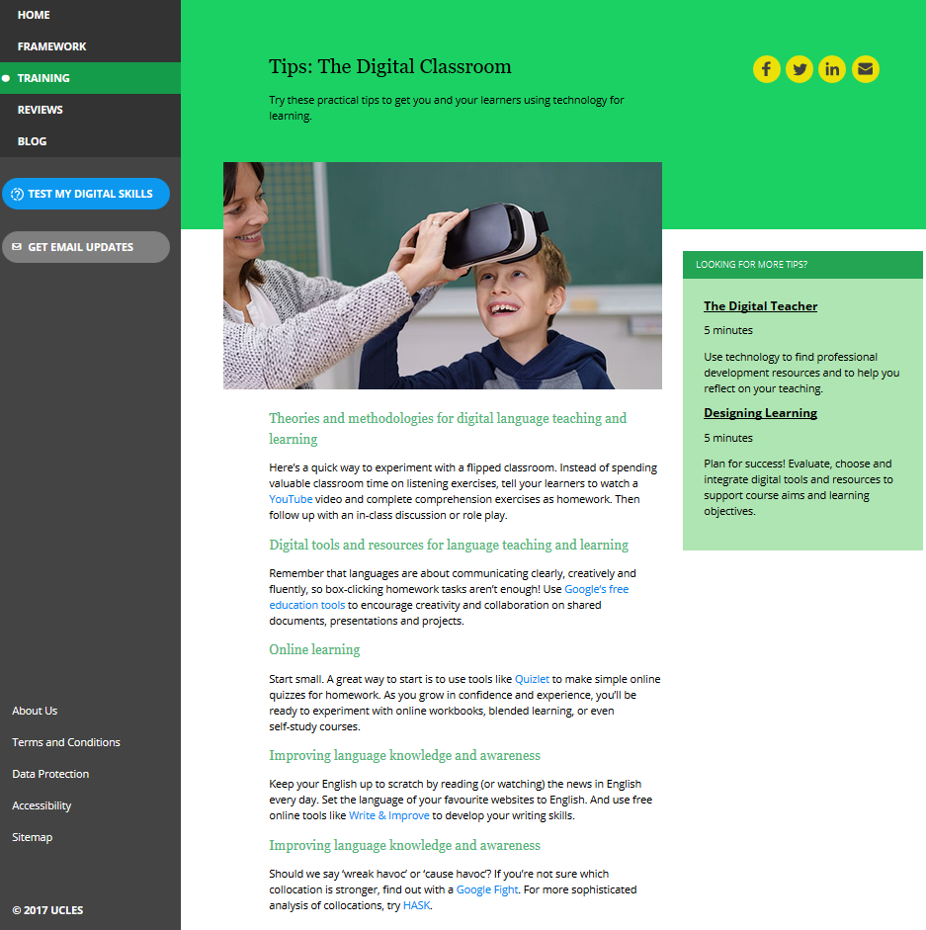

Slide 27
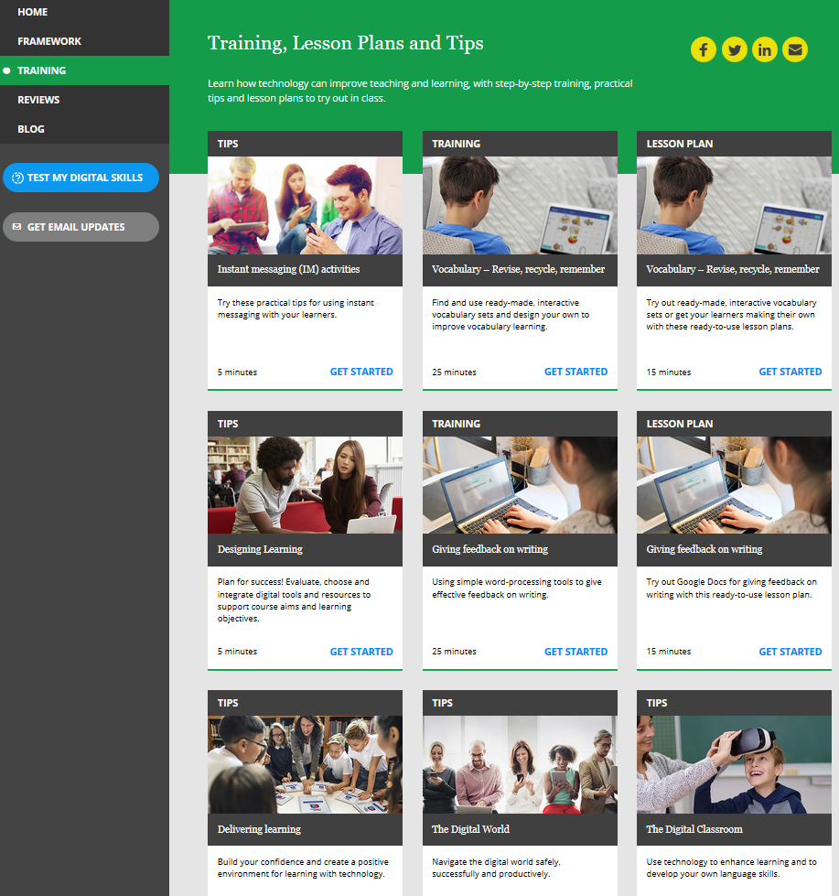

Slide 29
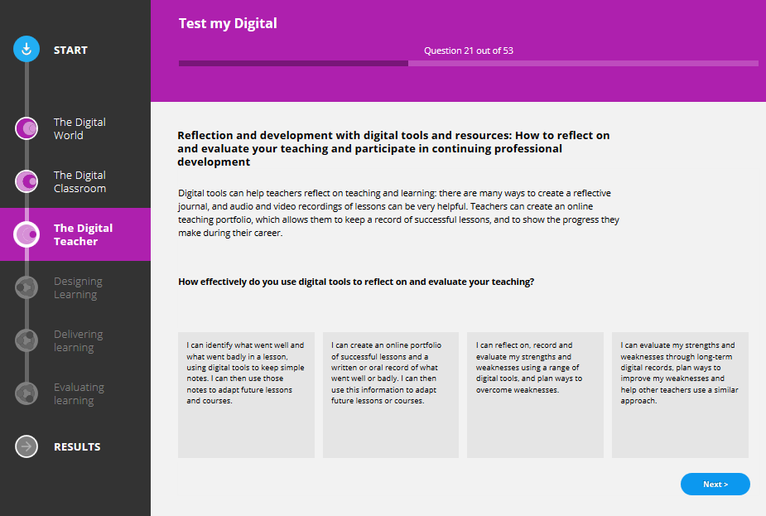

Slide 31
Your Digital CPD needs:
What digital skills & competences do you think you (and/or your staff) need to develop?
technical skills?
pedagogical skills?
materials development?
Reflection
Which competences & concepts
do you feel you need more input & training in?

Slide 32
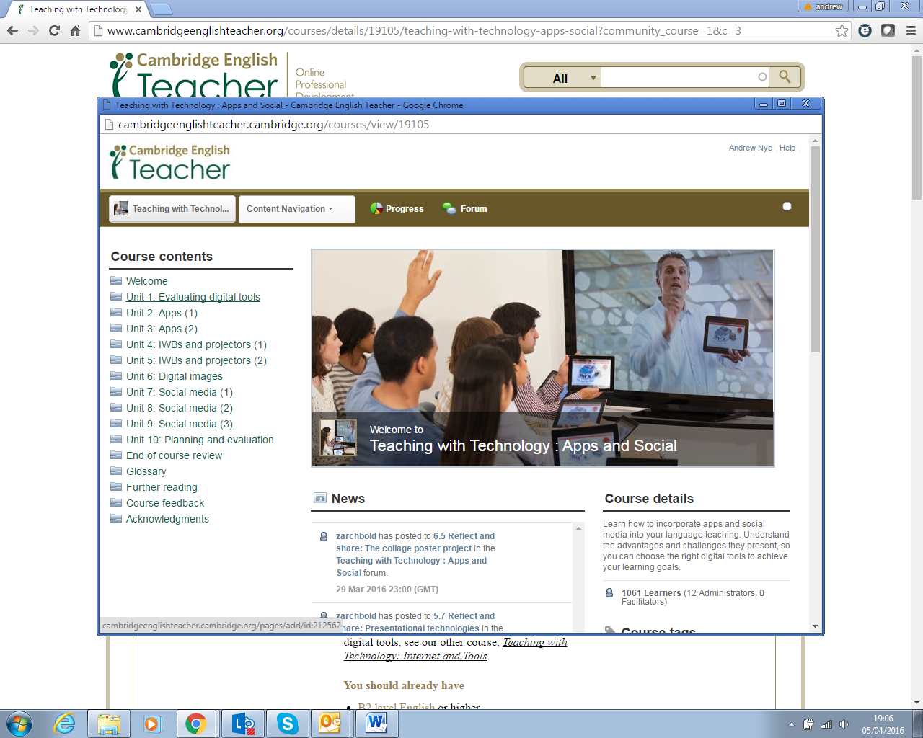
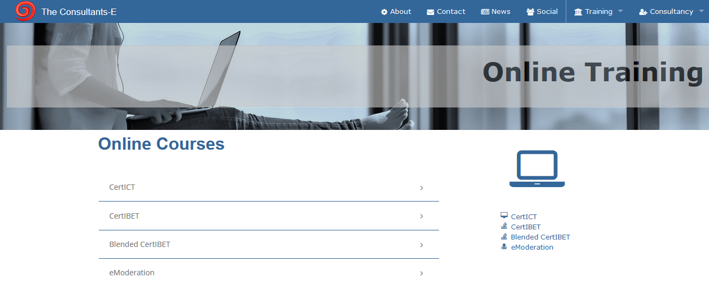
Digital training

Slide 33
ELTjam Academy

Slide 34
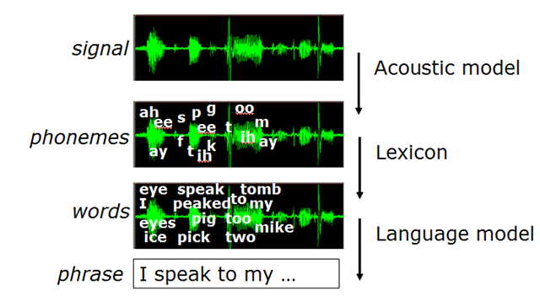
Speech-enabled tech
Digital speech &
ASR

Slide 35
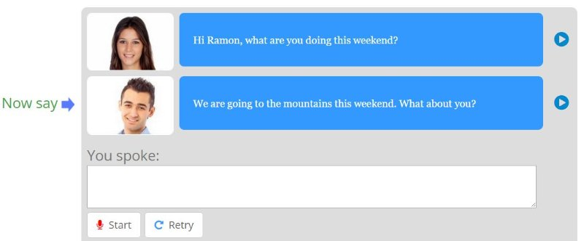
Interactive practice
Speaking Pal
short interactions in which the learner is required to speak with a virtual character. ASR can highlight words which are spoken incorrectly
Duolingo
Less sensitive ASR
cf. Reviews on ELTJAM
Other providers:
Sanako, SpeechAce, Dexway, Rosetta Stone
Results:
Works best if structured
Can be over-accepting
Caveat Emptor!
But…. better than no speaking practice at all, for some autonomous students

Slide 36
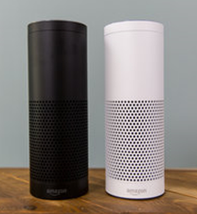
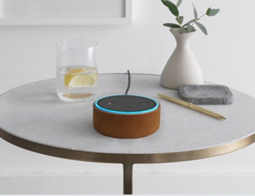
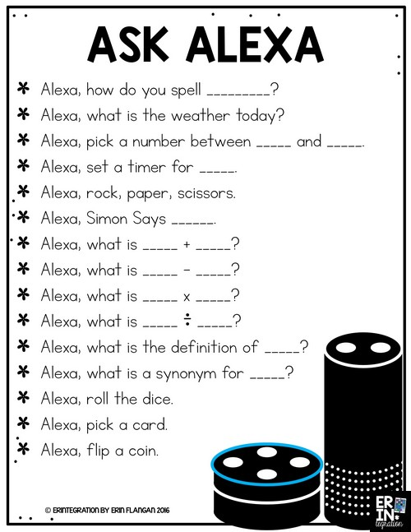
‘‘Alexa.…’’
Amazon Echo & Echo Dot
What’s the news?
Open the Telegraph
Launch National Rail
Play radio 4
What’s the weather in X?
Set a timer for 15 minutes
What's on my calendar for tomorrow?
Add 'go to the grocery store' to my to-do list
What’s on my to-do list?
How many degrees Fahrenheit in 22 degrees Celsius?

Slide 38
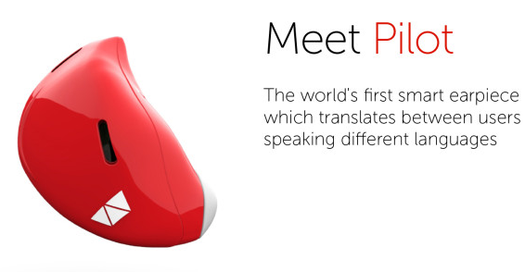
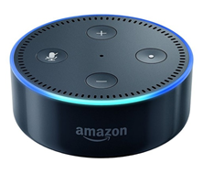
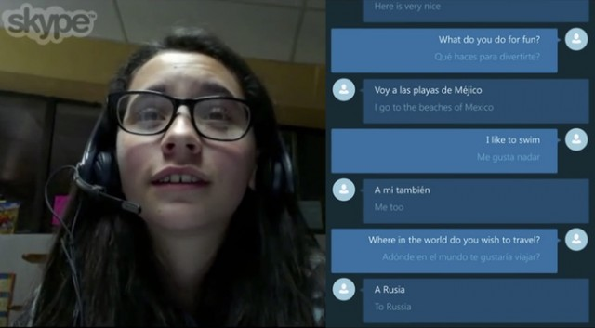
Speech-enabled translation (SET)

Slide 39
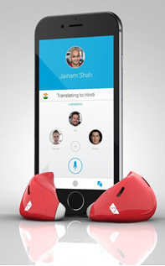
SET activity
SS write a dialogue in L1; then each translate their side into English and write it down, creating an English dialogue
Student A speaks her side in English and writes down spoken translation into L1
Student B speaks her side in English and writes down spoken translation into L1
Students compare the outputs and note differences from their original L1 dialogue
SS write a dialogue in L1
Student A speaks her side in L1 and writes down spoken translation into English
Student B speaks her side in L1 and writes down spoken translation into English
Students compare the outputs and note differences, asking for teacher guidance where needed

Slide 40
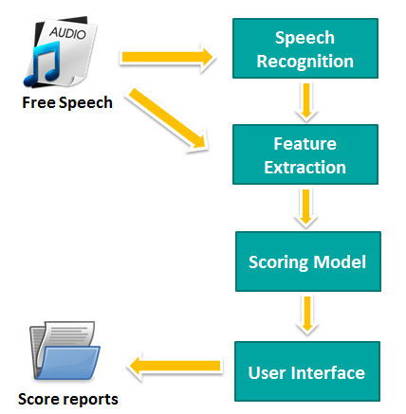
Linguaskill - Speaking
Auto-marker
Automated
marking

Slide 41
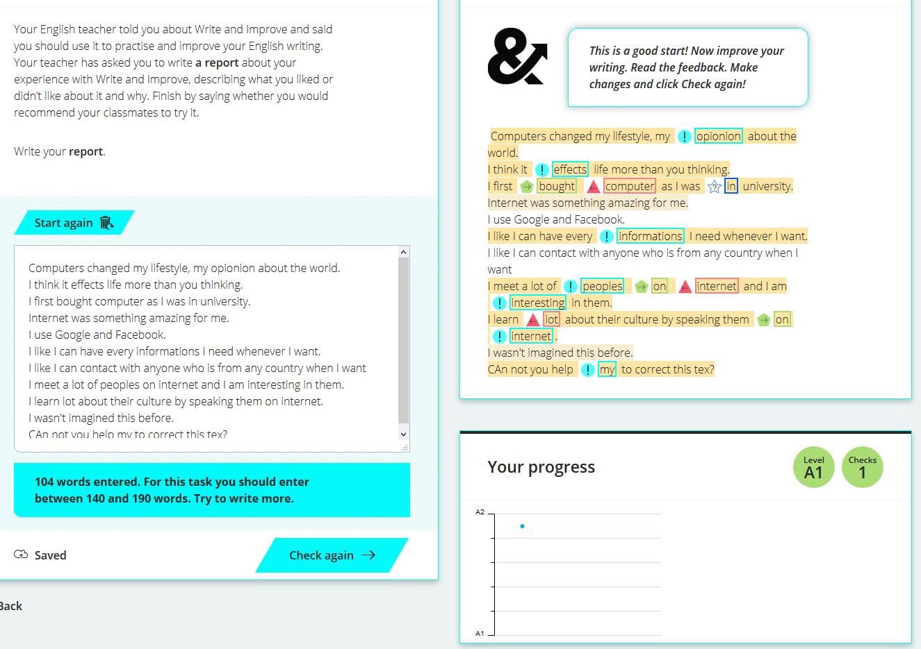
Writeandimprove.com

Slide 42
How could Automated Marking
help you and your students?
What does the instant availability of on-demand Speech-to-Speech translation mean for your teaching and your students’ learning?
How could it help your students, in and out of class?
Are there any challenges and drawbacks?
Reflection

Slide 43
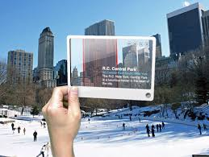
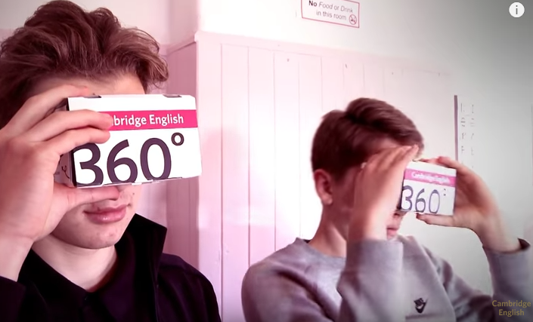
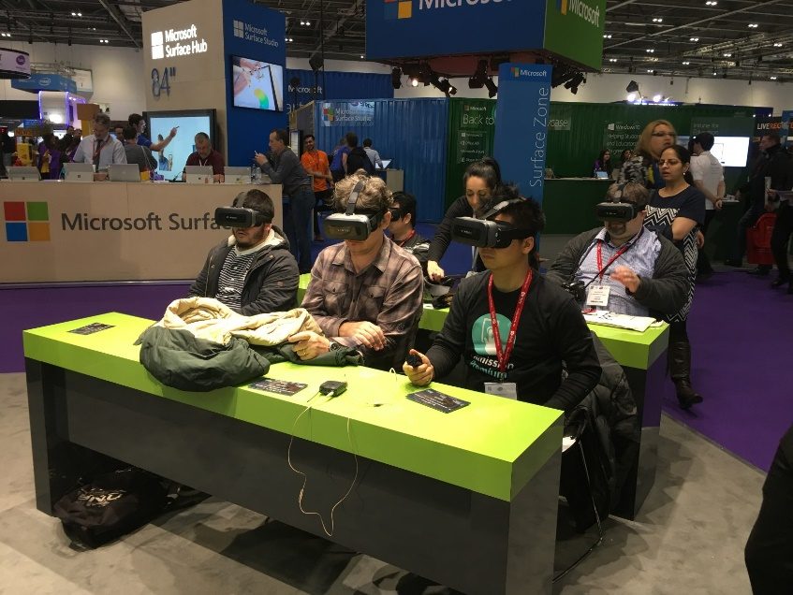
AR / VR / 360
Future directions…

Slide 44
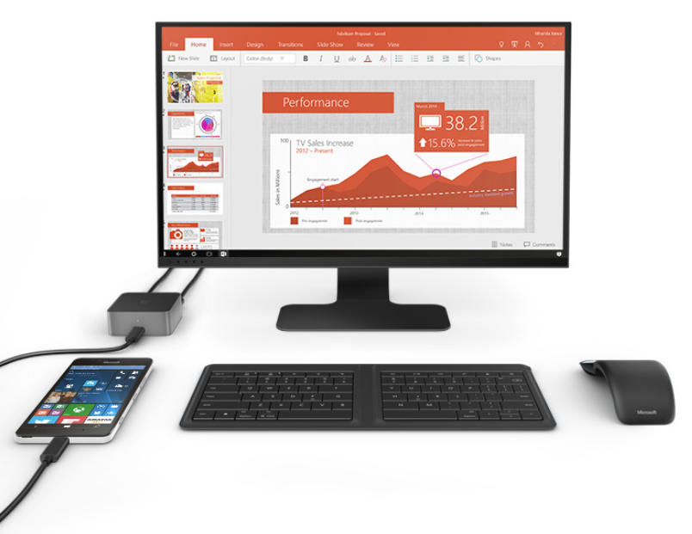
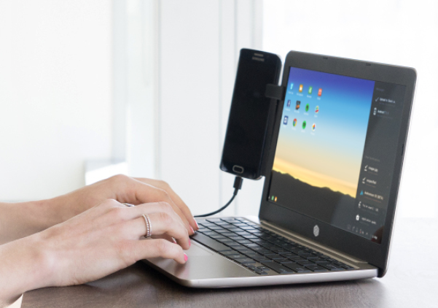
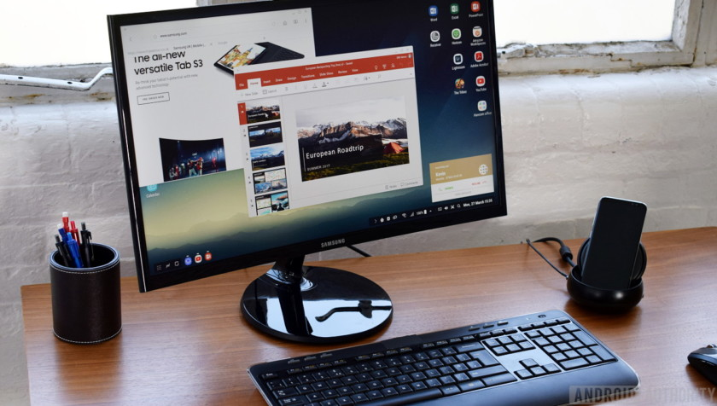
PC replacements
Device + dock + monitor = full PC experience
MS Display Dock, Samsung Dex, Lenovo Link, Nexdock…
Superbook: laptop shell

Slide 45
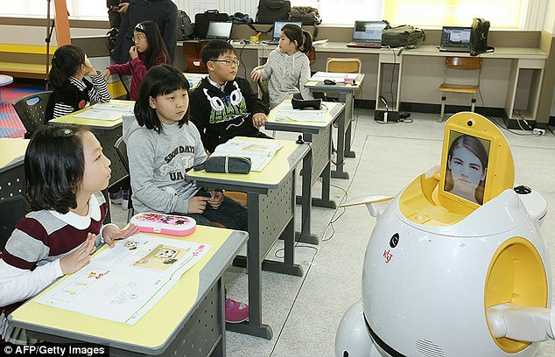
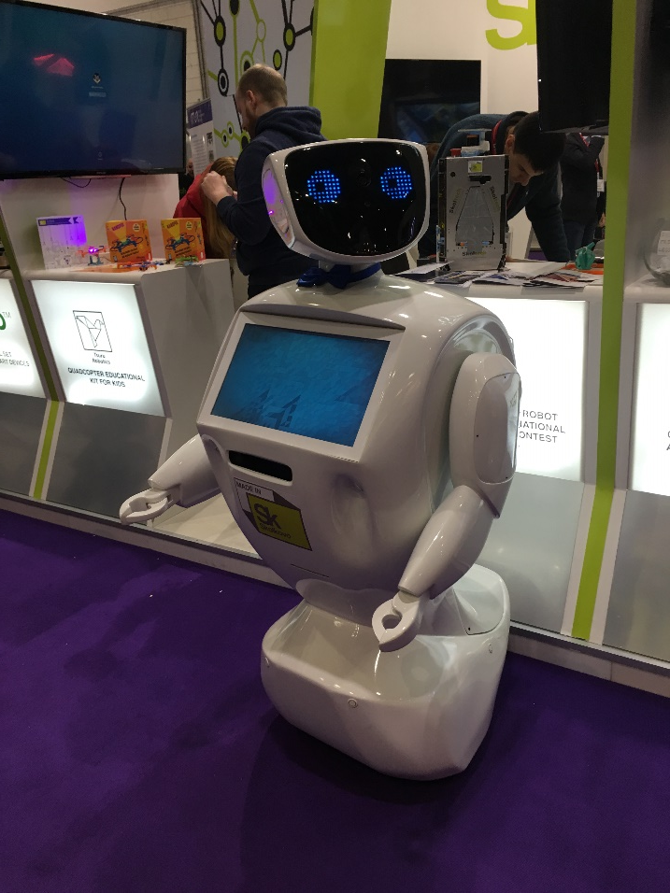
Robots

Slide 46
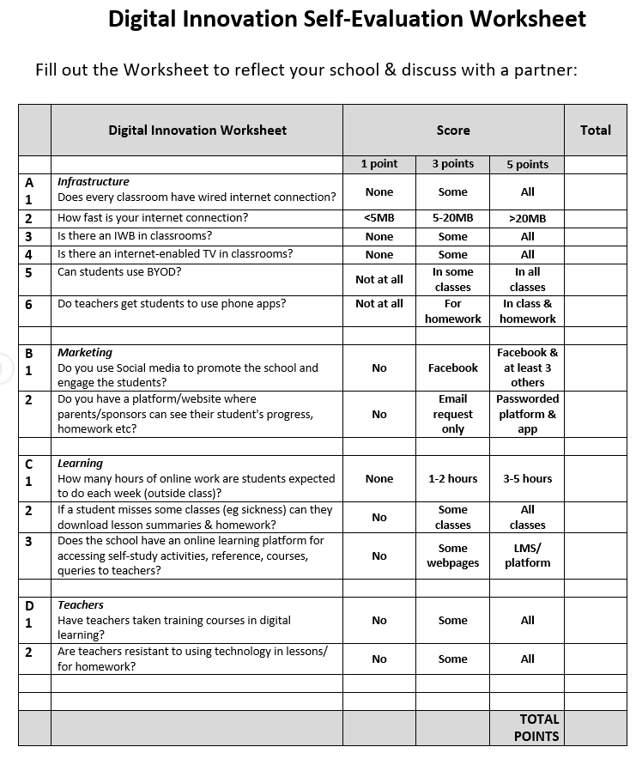
Reflection
Review your Digital Audit

Slide 47
Take Away
Define what teachers need to know
Plan training and development according to a competence framework
1
4
2
Help colleagues develop their Digital Literacy
5
Encourage curiosity & creation of resources
3
Fund training
& experimentation
in pedagogy & technology
6
Delight & engage students

Slide 48
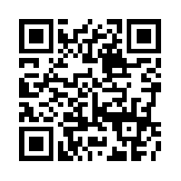
Thank you!
email: michael@highdale.org
PDF: http://www.michaelcarrier.com
Framework: http://thedigitalteacher.org
Journal of Training, Learning and Culture www.icc-languages.eu/tlcjournal
TIRF/Routledge book:
http://www.tirfonline.org

